Slide 1

Analyzing Mental Health:
Text Classification for Mental Health Conditions
Course Lecturer: Dr. Alexander(Sasha) Apartsin
Shahar Saadon | 206560526
Dudi Saadia | 318970944
Shanel Asulin | 205616014

Slide 2

Introduction
Problem & Objectives
Problem Description
We aim to classify a person's mental or emotional state based on a short text message (like a post or chat).
Why is it important?
It can help detect mental health issues early and support professionals in understanding emotional states.
Why is it challenging?
The texts are short, vague, and often written in informal or inconsistent language.

Slide 3
Introduction
Problem & Objectives
Project Goals
Explore if machine learning can classify emotional states from text.
Compare several models to find the best one.
Understand which words are most important for each emotion.

Slide 4
Dataset & Preparation
Data Sources
Main dataset: Over 53,000 text statements labeled with 7 mental health states. Additional dataset: Statements labeled by depression levels (Mild, Severe, Normal)
Merging Strategy
We added the new data to increase the number of examples.
>>All “Mild” and “Severe” were labeled as Depression
>>All “Normal” statements were labeled as Normal
Final Format
Text: short English statements from social media
Label: one of 7 categories (e.g., Anxiety, Depression, Stress, etc.)

Slide 5
Models and Processing Pipelines
Clean and label data
Train models
Transform text into vectors (TF-IDF)
Evaluate predictions using classification metrics
What we used:
Text preprocessing: TF-IDF vectorization with and without n-grams.
Models:
Naive Bayes
Logistic Regression
SVM
Random Forest
XGBoost
Training details:
* Train/Test split: 80/20.
*Balanced classes: using stratified split.
* Platform: Google Colab and local Jupyter Notebook.
* Batch size & epochs: default values for classical models.

Slide 6
How We Used the Metrics
Metrics Overview
We used Accuracy, Precision, Recall, and F1-Score to evaluate our models. These metrics helped us understand how well each model handled different emotional categories. During training - We monitored validation performance to check if the model was learning well or overfitting.
During testing - We compared all models using these metrics to select the best one.
Why we used multiple metrics
Accuracy alone is not enough in imbalanced data.
F1-Score helps balance between catching positive cases and avoiding false alarms.

Slide 7
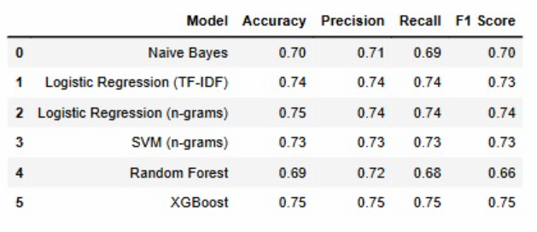
Intermediate & Baseline Results

Slide 8
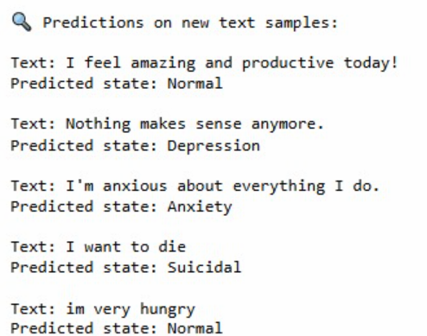
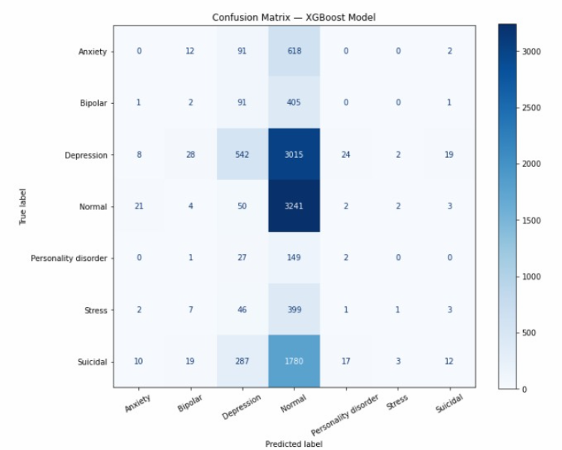
Main Results and Conclusion

Slide 9
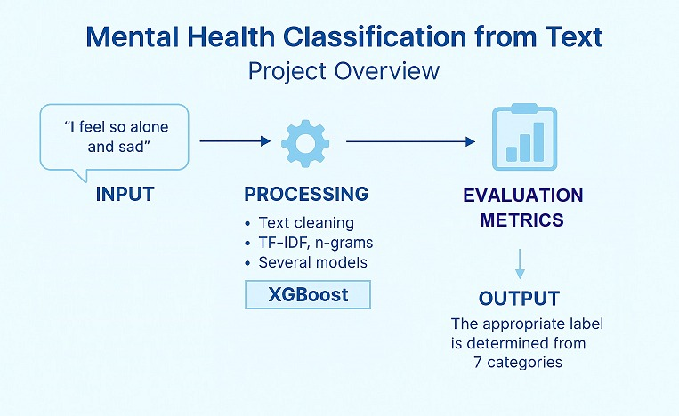
Graphical abstract

Slide 10
Thank You ☺

